Slide 1
DevOps
Bridging the Gap Between App Development and User
Patricia Donohue – Build & Release Engineer @ Everi Holdings Inc.

Slide 2
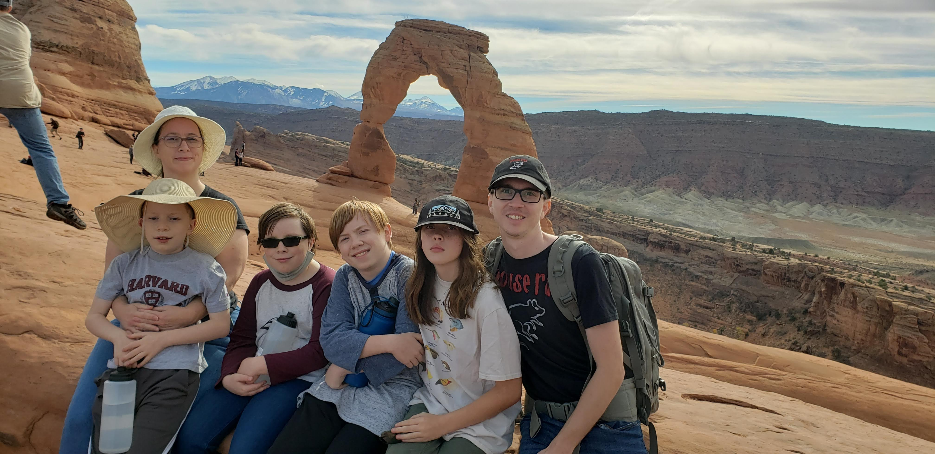
Who am I
Where I started
Third of eight children
Grew up in Boulder City
Attended CSN for base courses, then went on to UNLV
Dual Baccalaureate in Biology and Biochemistry in 2005
Attended graduate school at UNLV in SOLS, achieved PhD Candidate but never finished
Moved on to a career in IT – starting as an application developer (javascript, database)
Where I am now
Four children, aged 10, 12, and 15
The two 15-year-olds are in different magnet schools in 9th and 10th grade
Build and Release Engineer at Everi, in the process of moving into a DevOps role

Slide 3


Who is Everi

Slide 4
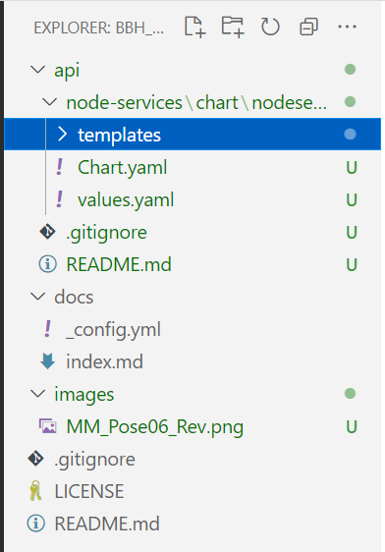
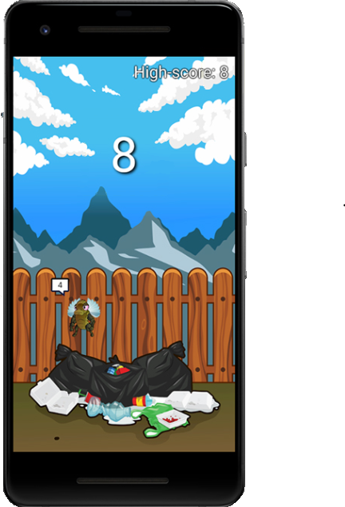



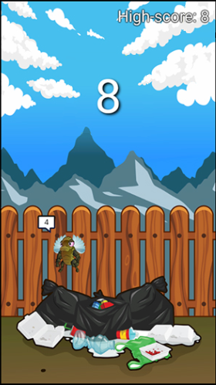
Really_Cool_App01
This Photo by Unknown Author is licensed under CC BY-NC

Slide 5
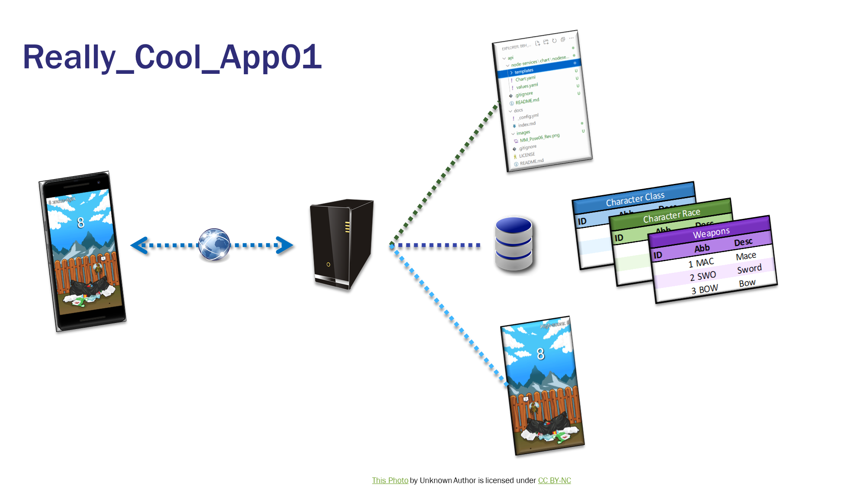
Cool_Application_01 has gone viral! Awesome, but now the real work starts!
Users on both app stores are finding bugs in the code and asking for new features
We enlist a few of our awesome friends to help tackle the bugs
Now we have source code conflict – both Sergio and Gabriela changed the same file, and Sergio’s changes overwrote Gabriela’s
The server we started with is getting overloaded with requests, and many users are complaining that they can’t access it
We need more server space and CPU.
Someone pointed out that the security of our application is sorely lacking
Hackers can login to the server and make changes to the file – we need to lock it down better

